Slide 1

Chapter 1:
Introduction to R Programming for Data Science

Slide 2
R Programming Fundamentals 1

Slide 3
Objective
Utilize conditional statements, “for” loops, and “while”
loops, in the R programming language
Work with functions in the R programming language
Work with functions for manipulating strings in the R programming language

Slide 4
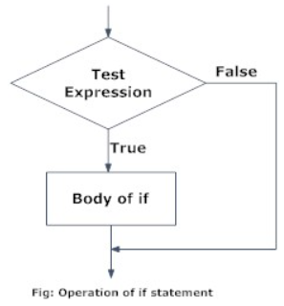
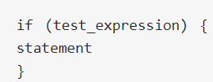

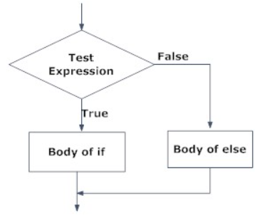
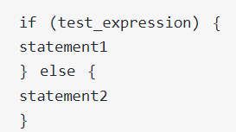
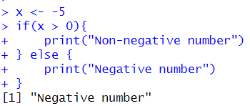
Conditional Statements
if statement
Flowchart of if statement
Syntax:
if…else statement
Flowchart of if …else statement
Syntax:
Chapter1- Importing Datasets

Slide 5
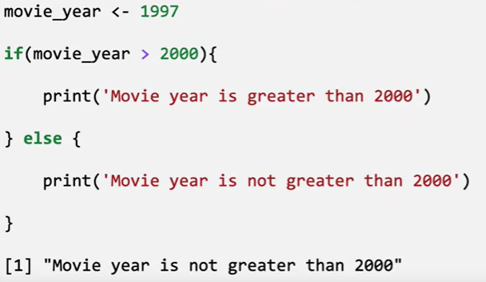
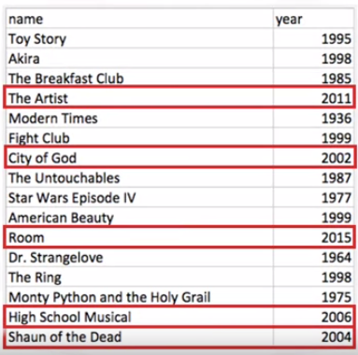
Conditional Statements
Example: Have a group of movies in a dataset. You want to only select the movies released after the year 2000.

Slide 6
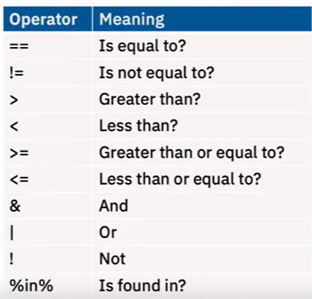
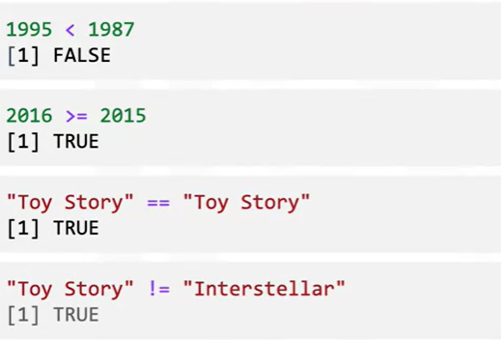
Conditions and Loops

Slide 7

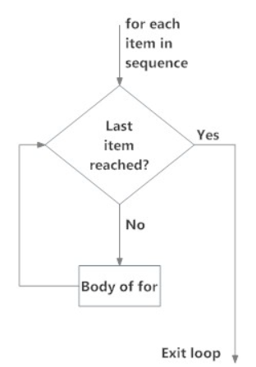
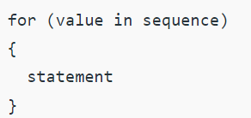
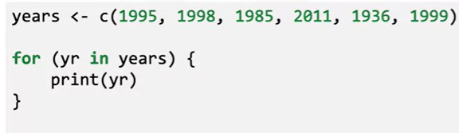
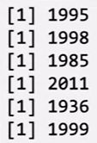
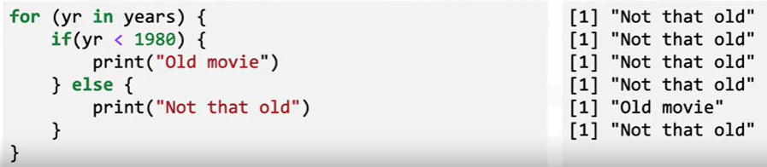
Conditions and Loops
Flowchart of for loop:
Syntax:
Example:

Slide 8

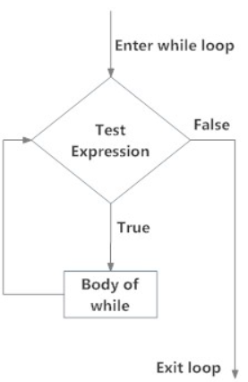
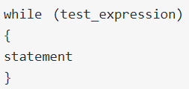
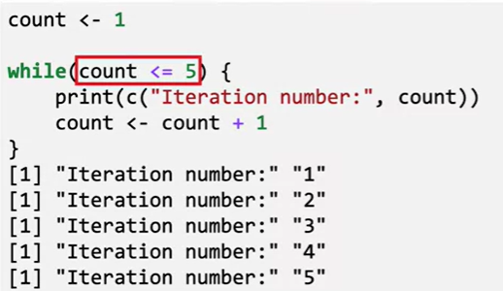
Conditions and Loops
Flowchart of while loop:
Syntax:
Example:

Slide 9
Functions in R
A function is a block of code that can be re-used in different parts of a program
There are two types of functions:
  Pre-defined functions
  User-defined functions

Slide 10
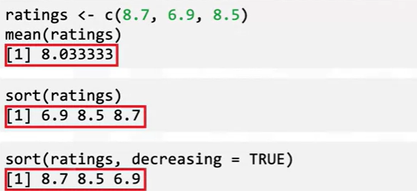
Functions in R
Pre-defined functions are the functions that are already defined. They’re built in to R or provided in a separate package.
Example

Slide 11
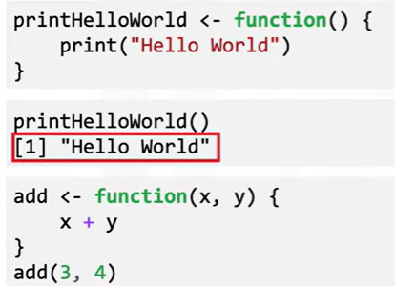
Functions in R
Functions that we define ourselves to do certain specific task are referred as user-defined functions.
Example
a function “printHelloWorld” is created
The “add” function here takes in two numbers,
produces the sum as output.

Slide 12
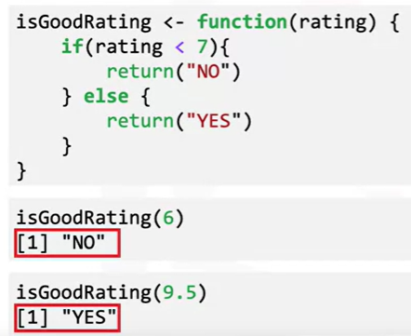
Functions in R
This function takes in a movie rating and runs through a conditional block
Function will return a different value depending on the input

Slide 13
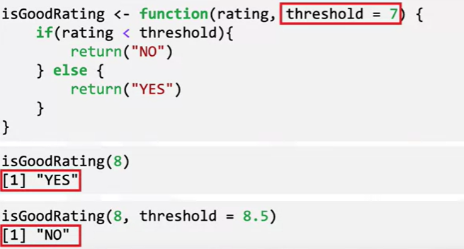
Functions in R
We can set a default value for a function argument

Slide 14
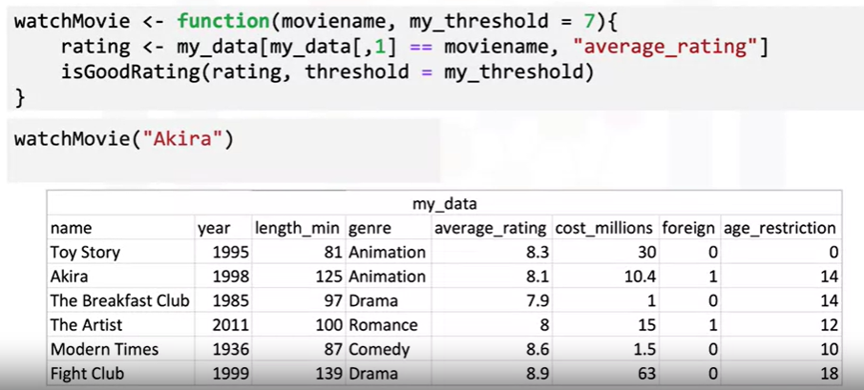
Functions in R
Notes:
So based on the dataset you see here, let’s take a look at the entire function’s structure. The function is called “watchMovie”, and it takes in the movie’s name, as well as a rating threshold.
This line is responsible for pulling the movie’s rating from the database. It does this by finding a matching name in the “name” column, and then finding the “average rating” value in the corresponding row.
In the next line of the function, we pass this rating to the “isGoodRating” function. “my threshold” is passed as well, but it has the same default value of 7.
So if we pass in the movie name “Akira”, the rating is 8.1, which is greater than the
default threshold of 7.
So the output will be “YES”.
We can also override the threshold, but 8.1 is still greater than 8, so once again we
get “YES” as output

Slide 15
Functions in R
Notes:
So based on the dataset you see here, let’s take a look at the entire function’s structure.
The function is called “watchMovie”, and it takes in the movie’s name, as well as
a rating threshold.
This line is responsible for pulling the movie’s rating from the database.
It does this by finding a matching name in the “name” column, and then finding the
“average rating” value in the corresponding row.
In the next line of the function, we pass this rating to the “isGoodRating” function.
“my threshold” is passed as well, but it has the same default value of 7.
So if we pass in the movie name “Akira”, the rating is 8.1, which is greater than the
default threshold of 7.
So the output will be “YES”.
We can also override the threshold, but 8.1 is still greater than 8, so once again we
get “YES” as output

Slide 16
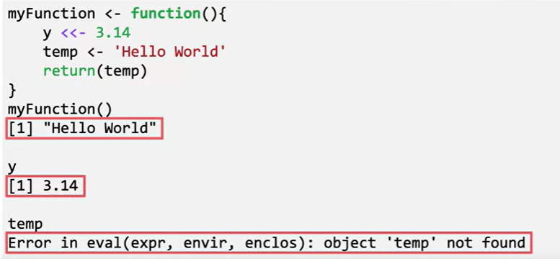
Functions in R
“y” is defined as a global variable,
so it can be accessed outside the
function
“temp” on the other hand is local, so it can only be accessed inside the function.
Notes:
So based on the dataset you see here, let’s take a look at the entire function’s structure.
The function is called “watchMovie”, and it takes in the movie’s name, as well as
a rating threshold.
This line is responsible for pulling the movie’s rating from the database.
It does this by finding a matching name in the “name” column, and then finding the
“average rating” value in the corresponding row.
In the next line of the function, we pass this rating to the “isGoodRating” function.
“my threshold” is passed as well, but it has the same default value of 7.
So if we pass in the movie name “Akira”, the rating is 8.1, which is greater than the
default threshold of 7.
So the output will be “YES”.
We can also override the threshold, but 8.1 is still greater than 8, so once again we
get “YES” as output

Slide 17



String Operations in R

Slide 18

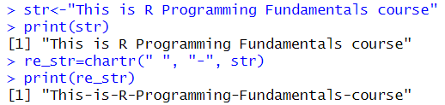
String Operations in R
chartr translates each character in x that is specified in old to the corresponding character specified in new

Slide 19

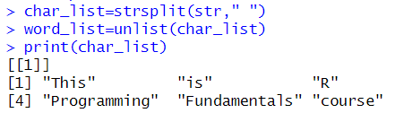
String Operations in R
Split the elements of a character vector x into substrings according to the matches to substring split within them.

Slide 20


String Operations in R
Sort (or order) a vector or factor (partially) into ascending or descending order

Slide 21

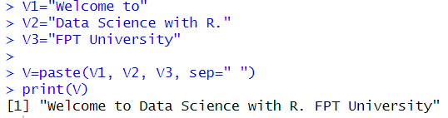
String Operations in R
Takes multiple elements from the multiple vectors and concatenates them into a single element.

Slide 22
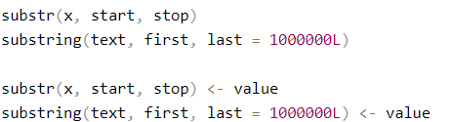

String Operations in R
Substrings of a Character Vector
Extract or replace substrings in a character vector.

Slide 23
Summary
At this point in the course, you know:
If statements use comparison and logical operators to test conditions in code.
For loops perform an operation for each item in a list, vector, or data frame column.
While loops perform an operation until a condition is no longer true.
Functions can be pre-defined or user-defined.
In user-defined functions, you can control the return value of a function, add logic using if statements, and call other functions.
You can define global variables using the <<- variable assignment operator.

Slide 24
Q & A
Chapter1- Importing Datasets

